Slide 1

pFogSim : An Environment for Performance Evaluation of Dynamic Fog Computing Systems
Jacob Hall, Jay McKinley, and Clayton Johnson

Slide 2
Introduction to Problem
Testing is Expensive
What you need...
Hardware
Time
Lots of Education
Community Support
Money
Fog Network Testing
Lots of hardware
Tons on time
Lots of I.T./Networking/CS skills
Etc...
Community demand for simulators is large

Slide 3
What is pFogSim?
It's our solution to these issues
Made to test Puddles Fog Architecture
Built off EdgeCloudSim
Offers dynamic networking
Fast, Cheap, and Easier
Other simulators
iFogSim
More Detailed Networking
Lacks Mobility/Dynamic Networks
Low Documentation
DynamicCloudSim
Dynamic
We’re pretty far in now

Slide 4
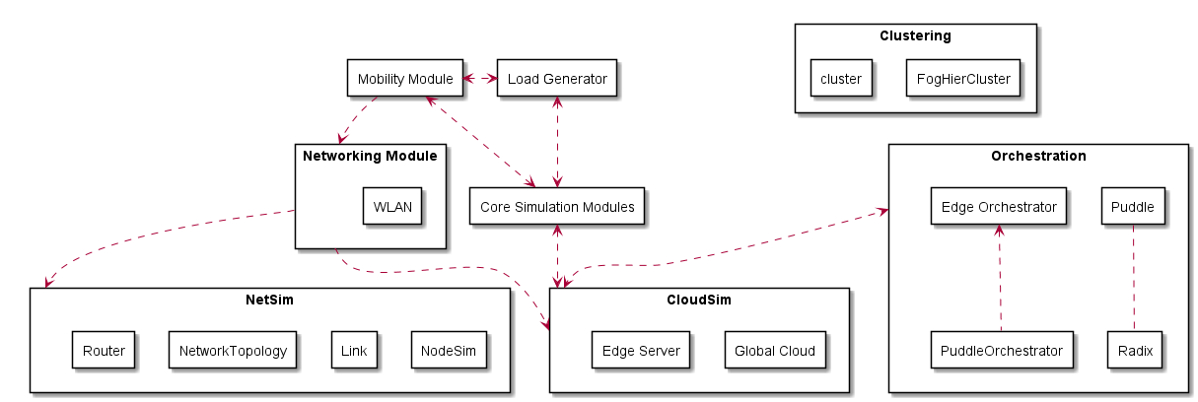
Terms…
Dynamic State Information
Static State Information
Centralized
Localized
Non-centralized

Slide 5
What's Been Changed?
Mobility Model
Defines bottom-level device movement (Sensors, Mobile Phones, Actuators)
Changed Inputs
Added iFogSim-like Networking
Created Testing Network with Thousands of Nodes
Puddle Architecture
Hierarchical Clustering
Allow for local pooling of resources
Allow latency-sensitive operations seamless execution
Service Migration
Tasks will Move where executed based on Mobile Device Position

Slide 6
General Program Flow
DataInterpreter → SimManager → EdgeServerManager → NetworkTopology → Clustering → Puddles
SimLogger ← SimManager ←VectorMobility
DataInterpreter
Converts Chicago CSV Dataset into XML
Creates Nodes/Links for tested Network
Intended to be adapter for data set
Changes for everyone
EdgeServerManager
Imports all data files + starts creations of Physical Topologies and
VectorMobility
Describes how mobile devices move
Scaled to average walking speed
Creates WAP connections

Slide 7
General Program Flow
DataInterpreter → SimManager → EdgeServerManager → NetworkTopology → Clustering → Puddles
SimLogger ← SimManager ←VectorMobility
NetworkTopology
Map representing the network
NodeSim represents location
Link represents hardwired links between nodes
Contains all static network state data
Router
Non-Centralized
Uses NetworkTopology
Uses Djikstra’s algorithm

Slide 8
General Program Flow
DataInterpreter → SimManager → EdgeServerManager → NetworkTopology → Clustering → Puddles
SimLogger ← SimManager ←VectorMobility
Clustering
Sorts machines into groups of logical groups
Starts by sorting machines into layers
Sorts layers into Puddles
Puddles
Logical grouping of machines
Machines are similar, homogeneous if possible
Machines are physically close to each other

Slide 9
General Program Flow
DataInterpreter → SimManager → EdgeServerManager → NetworkTopology → Clustering → Puddles
SimLogger ← SimManager ←VectorMobility
SimManager
Facilitates communication between all modules
Handles start and flow of execution
SimLogger
Stores and logs all data
Handles print and debug statements

Slide 10
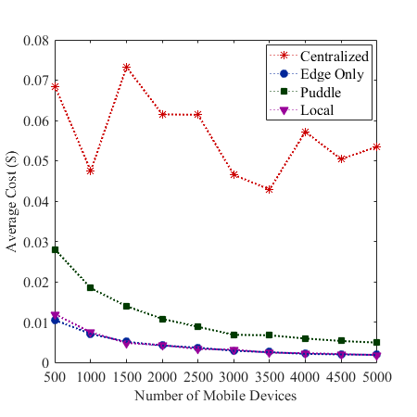
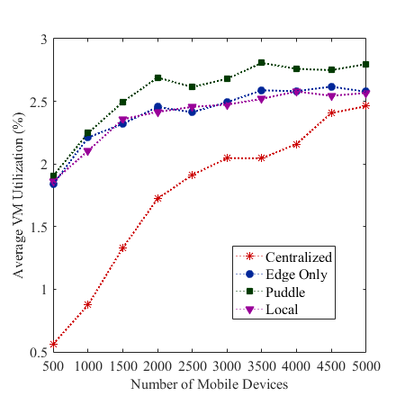
Preliminary Testing

Slide 11
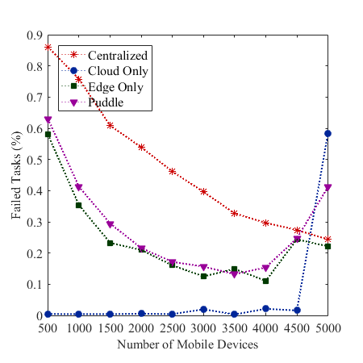
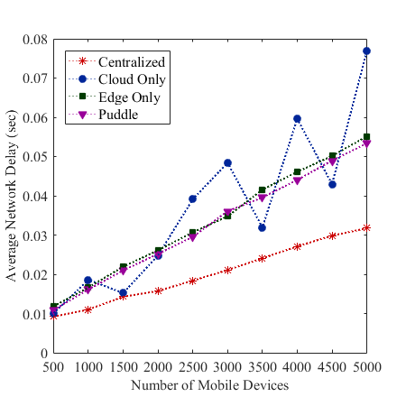
Preliminary Testing

Slide 12
Limitations
Nodes must have unique locations

Slide 13

What's Next?
Testing
Realistic scenario
Documentation
Allow for further improvements to be made upon our departure
Improve readability

Slide 14
Our Resources
C. Sonmez, A. Ozgovde and C. Ersoy, "EdgeCloudSim: An environment for performance evaluation of Edge Computing systems," 2017 Second International Conference on Fog and Mobile Edge Computing (FMEC), Valencia, 2017, pp. 39-44.
Gupta H, Vahid Dastjerdi A, Ghosh SK, Buyya R. iFogSim: A toolkit for modeling and simulation of resource management techniques in the Internet of Things, Edge and Fog computing environments. Softw Pract Exper. 2017;47: 1275–1296.
Scoca, Vincenzo & Aral, Atakan & Brandic, Ivona & De Nicola, Rocco & Uriarte, Rafael. (2018). Scheduling Latency-Sensitive Applications in Edge Computing. 158-168. 10.5220/0006706201580168.
Shehenaz Shaik and Sanjeev Baskiyar. 2018. Hierarchical and Autonomous Fog Architecture. In ICPP 2018: 47th International Conference on Parallel Processing Companion Proceedings, August 13-16, 2018, Eugene, OR, USA. ACM, New York, NY, USA, 8 pages. https://doi.org/ 10.1145/3229710.3229740
Yousefpour, Ashkan, Genya Ishigaki, Riti Gour, and Jason P. Jue. "On reducing iot service delay via fog offloading." IEEE Internet of Things Journal (2018).

